Slide 1

ORGANIC AGRI…

Slide 2
Group Members:
R. P. C. Thenuka – ITBIN – 2110 - 0110
T. N. Colambage – ITBIN – 2110 - 0159
W. W. K. N. Ranathunga – ITBIN – 2110 - 0141

Slide 3
About Our Business:
Organic Agri is an e-commerce platform which largely oriented around organic agriculture.
In our platform we sell potted plants, seeds, organic fertilizers and agricultural equipment.
We source all the items wide array of suppliers for our convenience.
We only accept supplies from reliable suppliers who meet standard quality requirements for organic farming.

Slide 4
Mission
“Making all Sri Lankan farmers concentrate on organic farming.”
Vision
“Bringing the whole world to organic farming.”

Slide 5
About Us:
We are an e-commerce platform that promotes organic farming.
Organic farming is emerging popular.
The most convenient platform to reach the audience is an e-commerce platform.
Our platform sells seeds, potted plants, agricultural equipment, and Organic fertilizers.
Currently our reach is only limited to customers of Sri Lanka.

Slide 6

Business Process…

Slide 7
Sales Process:
Customer can log in to the system and then select available products.
Then selected products and quantities will be updated in the cart.
After that customer can proceed to checkout and payment.
Hereafter proceed to the delivery process.

Slide 8
Delivery Process:
Once Payment and order is successfully executed by the customer.
Our accountant orders the warehouse manager to collect items and arrange shipment.
Then we will hand the shipment to a 3rd party courier service with delivery details.
3rd party will handle the delivery process and we collect anticipated delivery date.
If there was any inconvenience of delivery such as loss of shipment damaged, make a refund.

Slide 9
Procurement and Inventory Management:
This is largely done manually in this system.
Procurement of the product and adding new product to the system is supervised by the sales manager.
Adding new products and updating product details is carried out by the admin as reports of sales manager
And quality of each item is supervised and checked by the warehouse manager.
Sales manager manages the suppliers and the accountant handles the payments.

Slide 10

Reasons For Selecting An E-commerce Site…

Slide 11
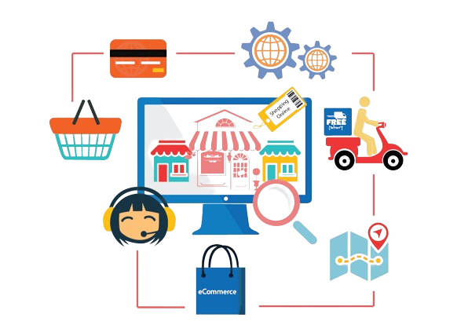
Because,
Global Market Access
24/7 Availability
Cost-Effectiveness
Market Expansion
Data Analytics
Scalability
Flexibility

Slide 12

Why Organic Agricultural Product Selling Website…

Slide 13
Why?
The main reason for choosing the organic agricultural product selling website is to give “health benefits” to our consumers. Because Organic Agricultural products are grown without synthetic pesticides, fertilizers, etc.
In addition,
- The whole world tends towards organic farming.
- Increase environmental sustainability.
- Reduced Chemical Exposure.
- Enhanced Soil Health.

Slide 14





CMS, Theme, Plugins, and Other Tools…

Slide 15

WordPress as a Content Management System(CMS).
Woostify as the Main Theme.
Plugins,
- Elementor
- WooCommerce
- payHere
- TI WooCommerece wishlist
- Contact Form 7
- Variations , etc
Other Tools,
- Canva

Slide 16
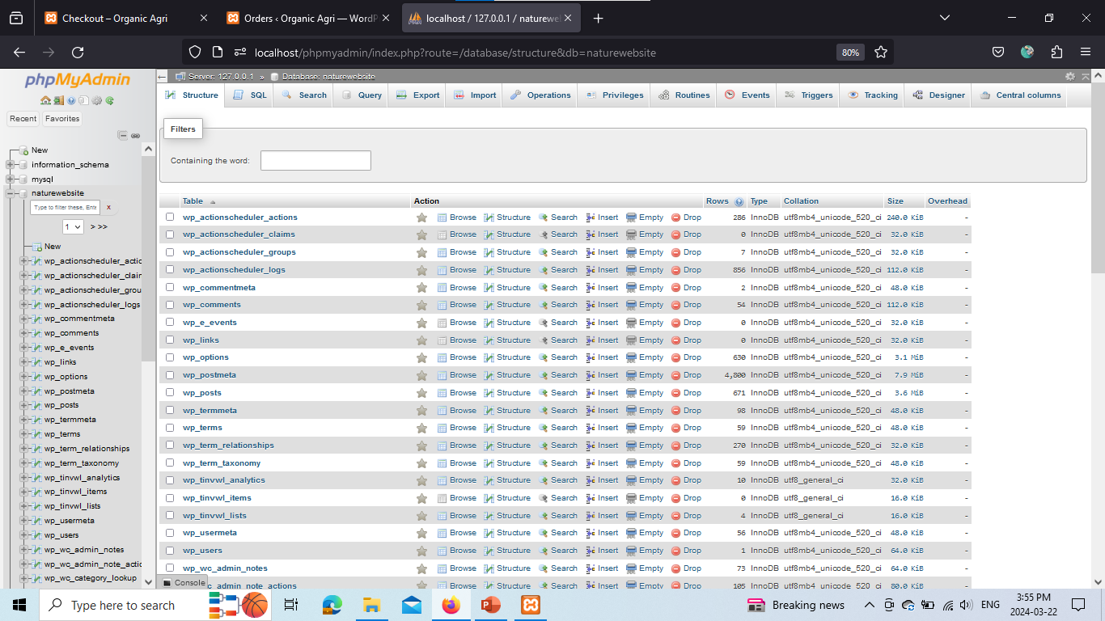
Database Screenshots

Slide 17
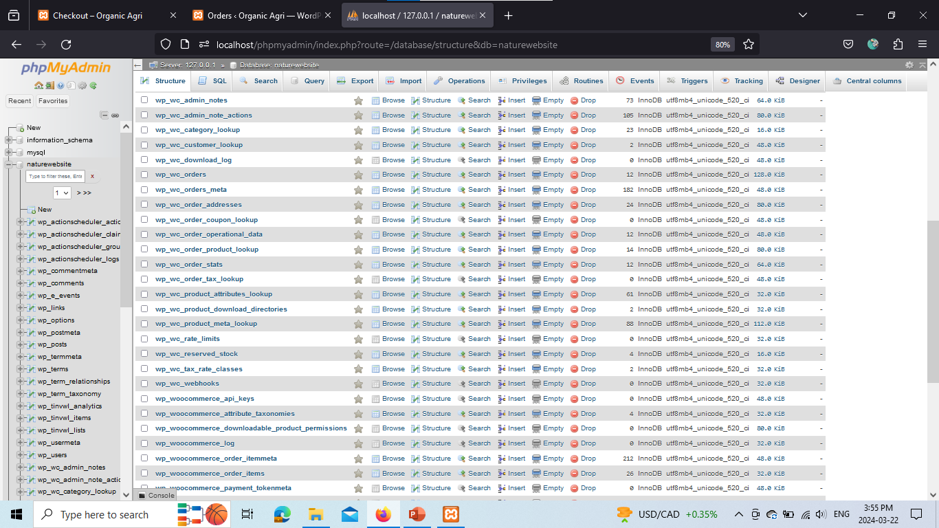
Database Screenshots

Slide 18
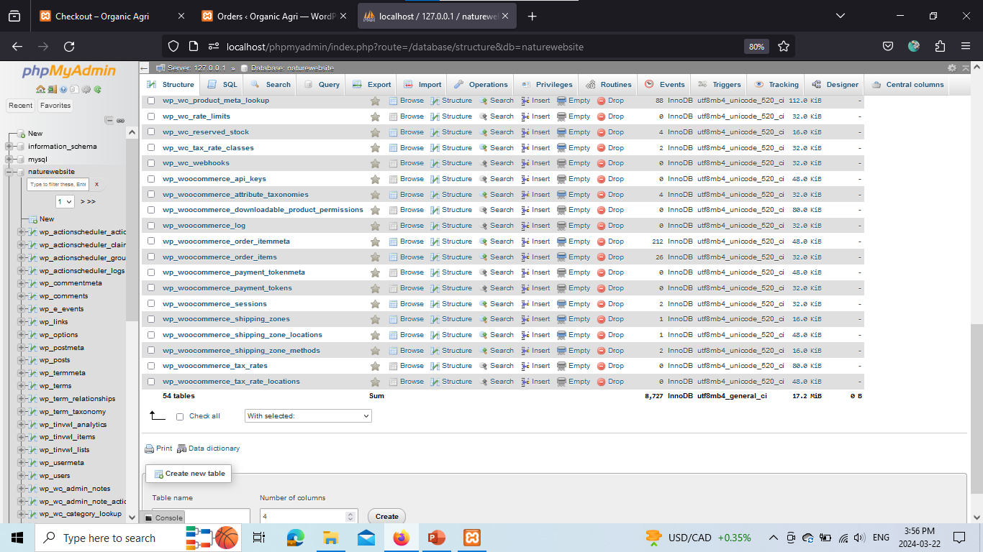
Database Screenshots

Slide 19
Let’s Move to Website…

